Slide 1

Client Dashboard
Data-Driven Business Insights

Slide 2

Introduction
This presentation provides a clear view of the client’s key performance indicators and business insights. It is designed to help understand customer trends, sales performance, and strategic opportunities for growth through data-driven analysis.
Effective use of visuals and concise explanations enable informed decision-making to advance business goals.

Slide 3

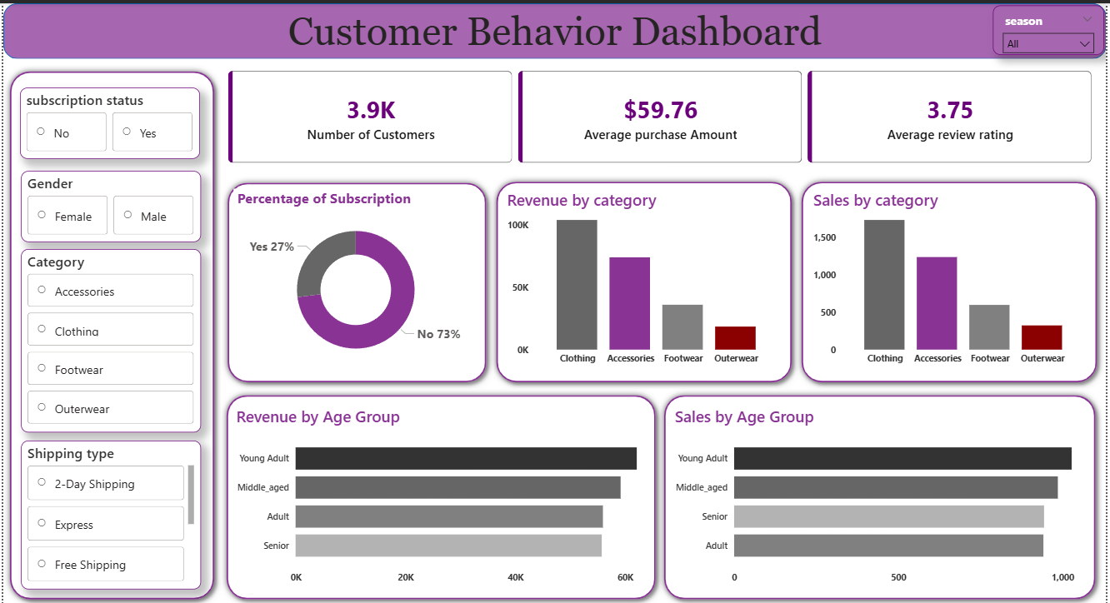
01
Dashboard Overview

Slide 4

Key Objectives & Executive Summary
The primary objective is to analyze customer and sales data to identify patterns and opportunities.
Key insights include overall revenue trends, customer segmentation, and purchasing behavior, subscription impact.
This summary equips stakeholders with a strategic snapshot for informed business actions.

Slide 5
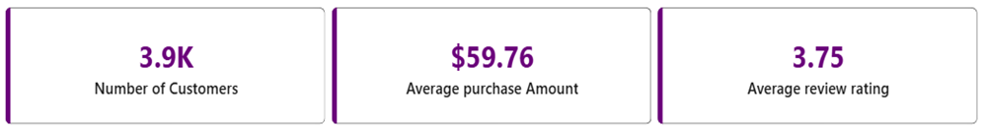
KPI Metrics and Visual Cards
Core KPIs include Total Revenue, Total Customers, Total Orders, and Average Order Value, Average Review rating.
Visual dashboard cards succinctly display these metrics to track business health at a glance.
The layout emphasizes clarity and quick comprehension for effective monitoring and reporting.
Dataset Size: 3,900
Customers Average Purchase Amount: $59.76
Average Review Rating: 3.75 / 5

Slide 6

01
Customer Analysis & Business Strategy

Slide 7

Customer Segmentation and Regional Performance
Customer segmentation reveals distinct groups based on purchase behavior and demographics, enabling tailored marketing strategies.
Revenue Contribution by Age Group
Age Group Revenue
Young Adult $62,143
Middle Aged $59,197
Adult $55,978
Senior $55,763
Visual tools such as pie charts and bar graphs are instrumental in understanding segment contributions and geographic distribution.

Slide 8
Customer Segmentation by Purchase History
Segment | Customers
Loyal | 3,116
Returning | 701
New | 83
Insights: - Majority of customers are Loyal buyers. - New customer acquisition is relatively low.
• 80%+ customers are Loyal buyers
• Very low number of new customers

Slide 9
Customer Behavior and Purchase Patterns
• Clothing is the highest revenue-generating category.
• Young Adults generate the most revenue.
• Non-subscribers generate higher total revenue than subscribers.
• Express shipping customers spend slightly more on average.
• Majority of customers are Loyal buyers.
• Discount usage is highest in Hat and Sneakers products.
Subscription Customers Avg Spent Total Revenue
Yes 1,053 $59.49 $62,645
No 2,847 $59.87 $170,436
• Non-subscribers generate almost 3× more total revenue.
• Average spending difference is minimal.
Repeat Buyers & Subscription Behavior Customers with more than 5 previous purchases:
Subscription Repeat Buyers
No 2,518
Yes 958
Insight: Repeat buyers are mostly non-subscribers.
Discount Usage – Top 5 Products Product % Purchases with Discount
Hat 50.00%
Sneakers 49.66%
Coat 49.07%
Sweater 48.17%
Pants 47.37%
Insight: Almost 50% of purchases in these products depend on discounts.

Slide 10
High-level Insights and Recommendations
The analysis reveals steady revenue growth with fluctuating customer acquisition rates. Sales trends indicate seasonal peaks, highlighting opportunities for targeted marketing.
Key insights emphasize the importance of focusing on high-value customers and improving retention rates. Strategic recommendations include enhancing customer segmentation and leveraging data to optimize product offerings.
These data-driven findings support informed decision-making to propel business growth.
Key Strategic Recommendations
1. Convert repeat buyers into subscribers.
2. Leverage high‑rated products for brand positioning.
3. Use discounts selectively for price‑sensitive products.
4.Strengthen new customer acquisition.
5. Promote Express shipping for premium orders.

Slide 11
Strategic Recommendations and Business Opportunities
Focus on enhancing digital marketing to capitalize on growth areas.
Promote Express Shipping
Target High Revenue Segment
• Focus on Young Adults
• Promote Clothing category
Develop targeted campaigns for high-value segments and under-penetrated regions.
Invest in retention programs and improve customer experience through data insights. Identifying emerging product demand offers potential for portfolio expansion and revenue increase.

Slide 12
Overall Business Health: GOOD with Growth Opportunities
If optimized strategically, revenue can increase by improving:
• Subscription engagement
• Young Adult targeting
• Discount personalization
• New customer acquisition campaigns

Slide 13

Conclusions
The comprehensive dashboard analysis provides actionable insights into customer behavior and sales trends.
Focusing on key metrics and customer segmentation offers a clear path for strategic initiatives.
These findings empower stakeholders to make informed decisions aimed at sustainable business growth and improved market positioning.
✔ Strong loyal customer base
✔ High-performing clothing category
✔ Stable average purchase value
✔ Effective discount-driven purchases

Slide 14
THANK YOU
THANK YOU

